Slide 1


#Le Cube Média
Keeping the mind of a collective activity,
by facilitating the assessment of contributions,
content storage and research
@JulienHoltzer
Manager of Sopra Steria, a digital service company
Co-founder in 2003 et president of Pobot.
Co-founder in 2014 with Telecom Valley of SoFAB, the Fab Lab of Sophia Antipolis.

Slide 2


Knowledge sharing, a fragile mechanism
I've been hosting and participating in a network of like-minded enthusiasts for ten years and I contribute regularly to scientific, technical and industrial projects
I have observed contributions and in every collective space, the same problems persist:
How to gather the most people all the while knowing that it's impossible for everyone to be together at the same time?
How to integrate new participants into an active, ongoing projects, or how to repeat a project several times?
How to encourage a more sustainable involvement and engagement among the collaborators?
Support d'expérimentation #LeCubeMedia

Slide 3
AN Appropriate solution to applications
It was obvious that the multimedia (especially video) was a great way of sharing with our collaborators the progress of our projects
But the tools are not entirely suitable: the process of carrying out a certain project interrupts the pace and the energy of collaboration and collecting data from different devices is tedious, therefore projects are frequently delayed or abandoned altogether.
The idea: facilitate contribution via a ubiquitous capturing device, with a minimum of user manipulation (easy and practical), and contents stored in a unique place
A DIY equipment was better perceived
and more favourable at encouraging its usage
Support d'expérimentation #LeCubeMedia

Slide 4
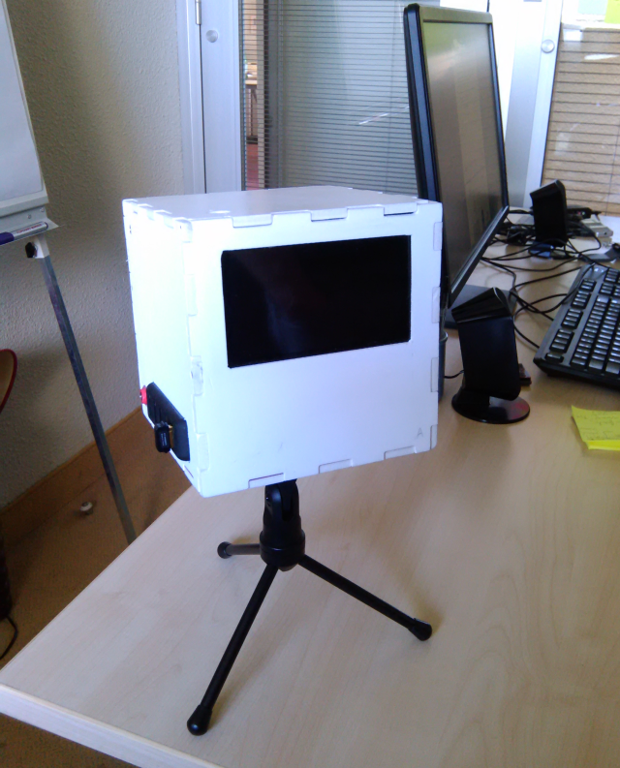
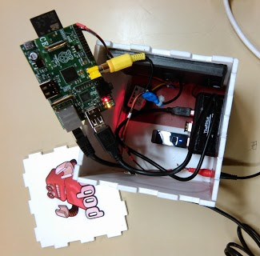
CURRENT Prototype: THE cube media
Demonstration: a sturdy object, extensible, open
Support d'expérimentation #LeCubeMedia

Slide 5
Accessible technologies
Microcomputer ''Raspberry Pi'' and HD camera
Open hardware electronic board « Arduino »
NFC tags
Wifi, Bluetooth, ZigBee, BLE connections
But at an affordable price thanks to the principle of DIY
And based on open source software adaptable to our particular needs
Support d'expérimentation #LeCubeMedia

Slide 6



















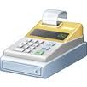
the first step to a grid of services
Video-mathon
Data storage
Presentation
Multimedia recording
Grid duplication
Content access
Stock monitoring
Statistics
Communication
Access control
Credit transfer
Invoicing
Support d'expérimentation #LeCubeMedia

Slide 7
Principe: A network of linked nfc tags
frequents >
Third Place
Contributor
knows how to use >
Ressource
needs >
follows>
knows >
Knowledge
Project
participate >
#LCM
Automatic creation of links
Hypertext → Hypersocial
Communication becomes simpler
Support d'expérimentation #LeCubeMedia
Notes:
<number>

Slide 8



Licences
This presentation and concepts:
http://creativecommons.org/licenses/by-sa/2.0/fr/
Equipment and manufacturing diagram:
http://www.oshwa.org/definition/french/
Software:
http://opensource.org/licenses/mit-license.php
Support d'expérimentation #LeCubeMedia

